Slide 1

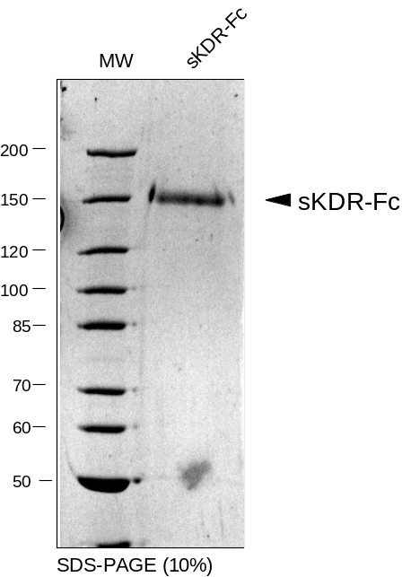
ReliaTech GmbH
Recombinant human soluble VEGFR-2 (D7)-Fc Chimera
(Cat #SFC-007 / -008)
Fig. 1: SDS-PAGE analysis of recombinant human VEGFR-2 (D7)-Fc (sKDR-Fc) produced in insect cells. Sample was loaded in 7% SDS-polyacrylamide gel under reducing conditions and stained with Silver stain.
http://www.reliatech.de / orders@reliatech.de

